Slide 1
Consumer
Producer
Living Organisms
Review and Quiz
Decomposer

Slide 2
Living Organisms
In an ecosystem, all living organisms must have a way to get food energy. We categorize organisms by the way they get their energy.

Slide 3
Producers
Producers use the Sun for food because they can carry on a process called photosynthesis. Producers are green plants. Chlorophyll is the substance that gives plants their green color. It also stores light energy from the Sun.

Slide 4
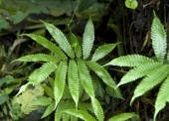
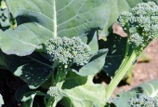
Examples of Producers
zenia
Fern
Broccoli plant

Slide 5
Consumers
Consumers must eat, or consume, other organisms to obtain energy. Consumers eat producers or eat other consumers. Animals and people are consumers. We eat plants or other animals for food energy.

Slide 6
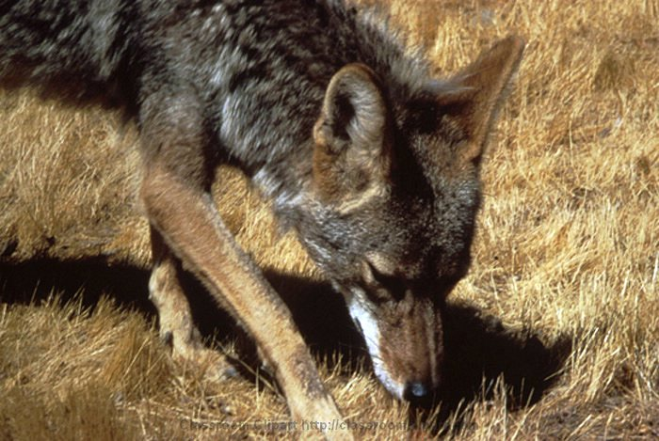
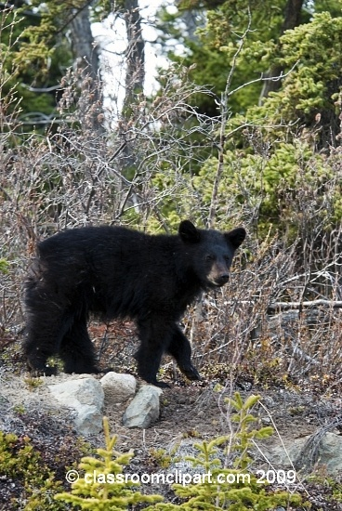
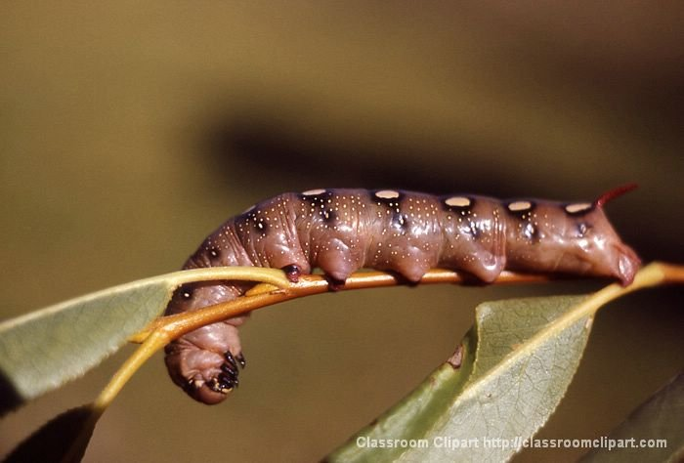
Examples of Consumers
Coyote
Bear
Caterpillar

Slide 7
Three Types of Consumers
Carnivore
Eats consumers
Sharp teeth
Herbivore
Eats producers
Flat teeth
Omnivore
Eats consumers and producers
Includes most people
Consumers

Slide 8
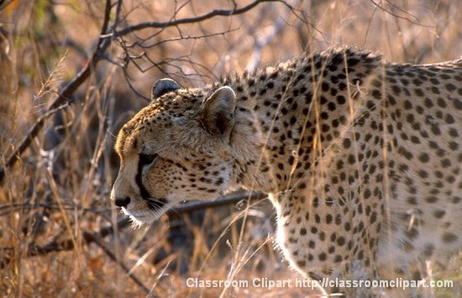
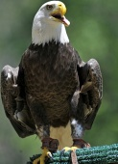
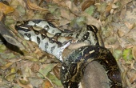
Examples of Carnivores
The cheetah’s diet consists of antelope, small mammals and birds.
The boa constrictor’s diet consists of rodents, lizards, birds, bats, and small mammals.
The bald eagle’s diet consists of fish, waterfowl, small mammals.

Slide 9
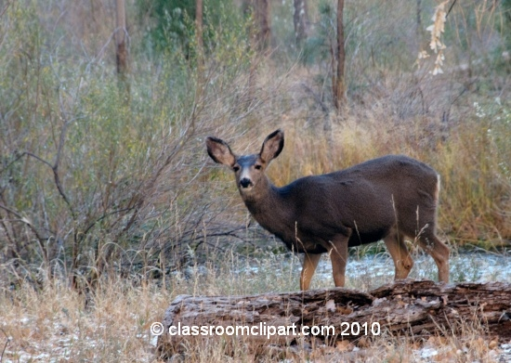
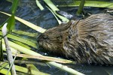
Examples of Herbivores
The caterpillar’s diet consists of the leaves of flowering plants and trees.
The deer’s diet consists of green plants, buds, twigs, and acorns.
The beaver’s diet consists of twigs, shoots, leaves, and tree bark.

Slide 10
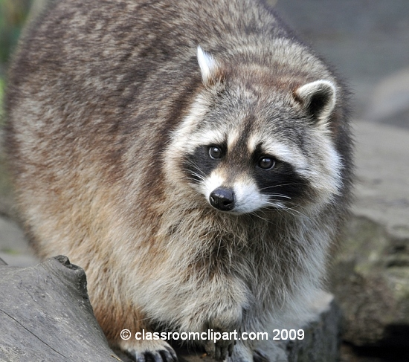
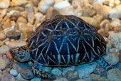
Examples of Omnivores
The raccoon’s diet consists of fruit, grain, fish, insects, and earthworms.
The turtle’s diet consists of fish, snails, earthworms, and plants.
The bear’s diet consists of insects, beetles, grasses, and fruits.

Slide 11
Decomposers
Decomposers feed on the wastes of living organisms and on dead, decaying plants and animals. They help to return nutrients from decaying matter back into the soil.

Slide 12
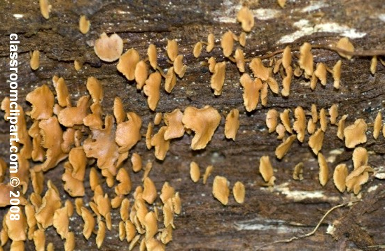
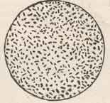
Examples of Decomposers
fungi
bacteria
earthworm

Slide 13
Consumer
Producer
Quiz Time!
Let’s find out what you know.
Decomposer

Slide 14
Question #1: What is a producer?
Click here
A living organism that must eat other organisms to get food energy.
A living organism that can make its own food using
sunlight, a process called photosynthesis.
C) A living organism that gets its food energy from wastes of other organisms or by breaking down dead organisms.
Click here
Click here

Slide 15
Answer A is incorrect.
A living organism that must eat other organisms for food is called a consumer.
Examples of consumers include:
Bear
Coyote
Caterpillar
Go back and try again.
Click here

Slide 16
Answer B is correct.
A living organism that makes its own food through a process called photosynthesis is called a producer. Producers are green plants.
Examples of producers include:
fern
broccoli plant
zenia
You’re ready for the next question.
Click here

Slide 17
Answer C is incorrect.
A living organism that gets energy from the wastes of other organisms or by breaking down the dead cells of organisms is called a decomposer.
Examples of decomposers include:
fungi
earthworm
bacteria
Go back and try again.
Click here

Slide 18
Question #2: What is a consumer?
Click here
A living organism that must eat other organisms to get food energy.
A living organism that can make its own food using
sunlight, a process called photosynthesis.
C) A living organism that gets its food energy from wastes of other organisms or by breaking down dead organisms.
Click here
Click here

Slide 19
Answer A is correct.
A living organism that must eat other organisms for food is called a consumer.
Examples of consumers include:
Bear
Coyote
Caterpillar
You’re ready for the next question.
Click here

Slide 20
Answer B is incorrect.
A living organism that makes its own food through a process called photosynthesis is called a producer. Producers are green plants.
Examples of producers include:
fern
broccoli plant
zenia
Go back and try again.
Click here

Slide 21
Answer C is incorrect.
A living organism that gets energy from the wastes of other organisms or by breaking down the dead cells of organisms is called a decomposer.
Examples of decomposers include:
fungi
earthworm
bacteria
Go back and try again.
Click here

Slide 22
Question #3: What is a decomposer?
Click here
A living organism that must eat other organisms to get food energy.
A living organism that can make its own food using
sunlight, a process called photosynthesis.
C) A living organism that gets its food energy from wastes of other organisms or by breaking down dead organisms.
Clickhere
Click here

Slide 23
Answer A is incorrect.
A living organism that must eat other organisms for food is called a consumer.
Examples of consumers include:
Bear
Coyote
Caterpillar
Go back and try again.
Click here

Slide 24
Answer B is incorrect.
A living organism that makes its own food through a process called photosynthesis is called a producer. Producers are green plants.
Examples of producers include:
fern
broccoli plant
zenia
Go back and try again.
Click here

Slide 25
Answer C is correct.
A living organism that gets energy from the wastes of other organisms or by breaking down the dead cells of organisms is called a decomposer.
Examples of decomposers include:
fungi
earthworm
bacteria
You’re ready to go on to the next question.
Click here

Slide 26
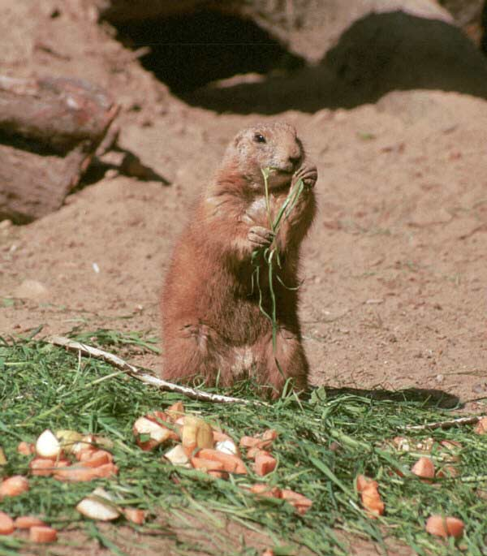
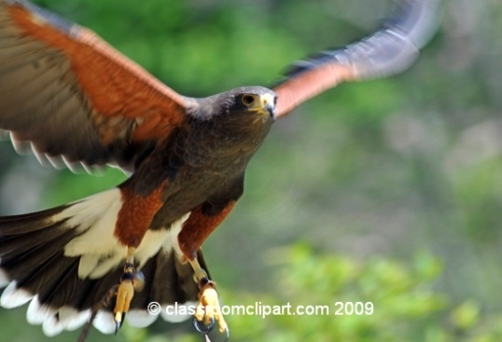
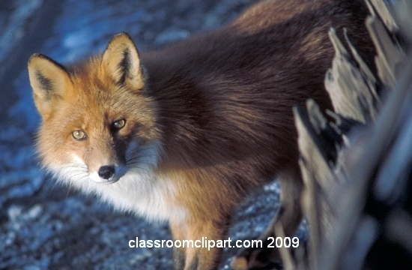
Herbivore, Carnivore, or Omnivore?
Which of these animals is an herbivore?
hawk
red fox
prairie dog
Click here
Click here
Click here

Slide 27
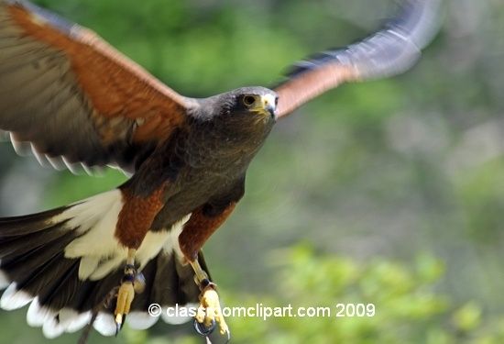
Herbivore, Carnivore, or Omnivore?
Sorry! A hawk is not an herbivore.
A hawk’s diet consists of rabbits, snakes, lizards and other small rodents. Because it eats meat only, it is a carnivore.
Click here
Go back and try again.

Slide 28
Herbivore, Carnivore, or Omnivore?
Congratulations! A prairie dog is an herbivore.
A prairie dog’s diet consists of grasses, roots, weeds, and blossoms. Because they eat plants, prairie dogs are herbivores.
Click here
You’re ready for the next question.

Slide 29
Herbivore, Carnivore, or Omnivore?
Sorry! A red fox is not an herbivore.
A red fox’s diet consists of crickets, grass, berries, squirrels, and mice. Because it eats both plants and animals, it is an omnivore.
Click here
Go back and try again.

Slide 30
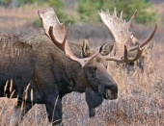
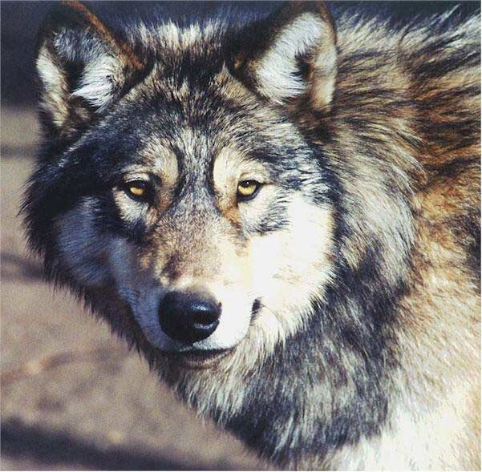
Herbivore, Carnivore, or Omnivore?
Which of these animals is a carnivore?
moose
raccoon
wolf
Click here
Click here
Click here

Slide 31
Herbivore, Carnivore, or Omnivore?
Sorry! A moose is not a carnivore.
A moose’s diet consists of twigs, leaves, and buds. Because it eats plants, it is a herbivore.
Click here
Go back and try again.

Slide 32
Herbivore, Carnivore, or Omnivore?
Sorry! A raccoon is not a carnivore.
A raccoon’s diet consists of fruit, acorns, fish, and earthworms. Because it eats both plants and animals, it is an omnivore.
Click here
Go back and try again.

Slide 33
Herbivore, Carnivore, or Omnivore?
Congratulations! A wolf is a carnivore.
A wolf’s diet consists of deer, moose, elk, and caribou. Because it eats other animals, it is a carnivore.
Click here
You’re ready for the next question.

Slide 34
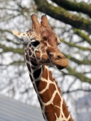
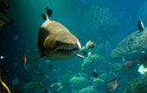
Herbivore, Carnivore, or Omnivore?
Which of these animals is an omnivore?
humans
shark
giraffe
Click here
Click here
Click here

Slide 35
Herbivore, Carnivore, or Omnivore?
Congratulations! Humans are omnivores.
A human may eat fruits, vegetables, breads, or a steak. Because people eat meat and plants, we are omnivores.
You’ve passed the test!
Click here

Slide 36
Herbivore, Carnivore, or Omnivore?
Sorry! A shark is not an omnivore.
A shark eats fish, squid, sea lions, and seals. Because they only eat other consumers, they are carnivores.
Click here
Go back and try again.

Slide 37
Herbivore, Carnivore, or Omnivore?
Sorry! A giraffe is not an omnivore.
A giraffe eats twigs of trees, grasses, and fruit. Because it only eats plants, the giraffe is an herbivore.
Click here
Go back and try again.

Slide 38
Consumer
Producer
If you’d like to learn more or play games, click the link below.
play a game
Decomposer

