Slide 1

Let’s chat about
ecosystems!

Slide 2
Allison: What is an ecosystem?
Mr. Brown: An ecosystem is made up of organisms that interact with one another and with their physical environment.

Slide 3
Allison: I’m still not sure I understand.
Mr. Brown: Let’s look at some examples.

Slide 4
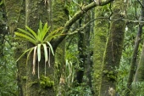
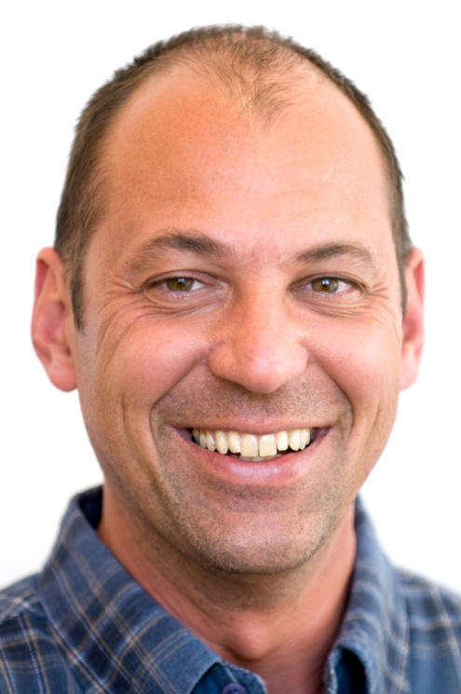
A tropical rain forest is an ecosystem. Here banana trees provide food for insects, insects are eaten by the red-eyed tree frog, and the frog is eaten by a Jaguar. All of these species also rely on the nonliving parts of the environment like soil, sunlight, and water.

Slide 5
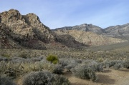
Another example of an ecosystem is a desert. Here a mule deer eats sage brush, but is eaten by a mountain lion. These animals also depend on water, sunlight, and soil which are the nonliving parts of the environment.

Slide 6
You should also know that an ecosystem doesn’t have to be large. A puddle on the sidewalk can be a home to several types of microbes. This is a tiny ecosystem.

Slide 7
Allison: Those examples helped, but how are
things like soil and sunlight part of the ecosystem?
Mr. Brown: Those are the abiotic factors in the ecosystem and they are very important. Let me show you why!

Slide 8

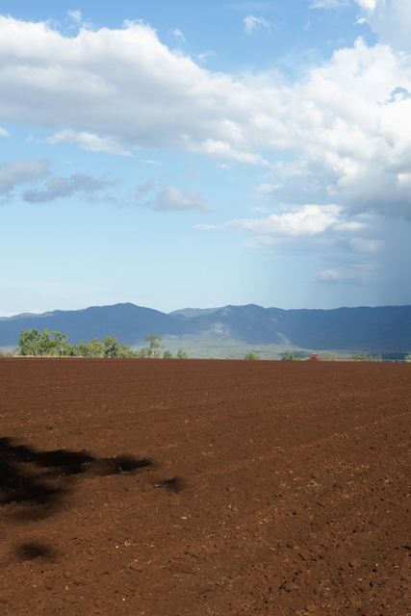
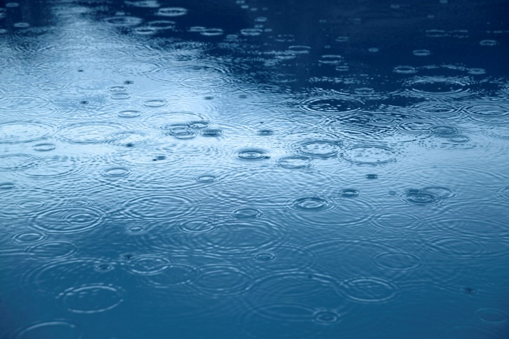
sunlight
soil
water
Sunlight is nonliving. However, all living things need the Sun. It gives us light and warmth. Green plants called producers take in carbon dioxide, water, and energy from the Sun and change them into sugar and oxygen. This is called photosynthesis.
Plants grow in the soil and get water and nutrients from the soil. All animals and people need to eat these plants, so we all rely on the soil.
All living things need water to survive. Plants use water to carry on photosynthesis. Animals and people must drink water.

Slide 9
Allison: Are sunlight, soil, and water the only
Abiotic factors?
Mr. Brown: No, there are other abiotic factors. The temperature and atmosphere are two other nonliving factors that effect how plants and animals live.

Slide 10
Allison: If the nonliving things are called abiotic
factors, what are the living things called?
Mr. Brown: The living things are called biotic factors. Biotic factors actually include
anything that is living or was once living.

Slide 11
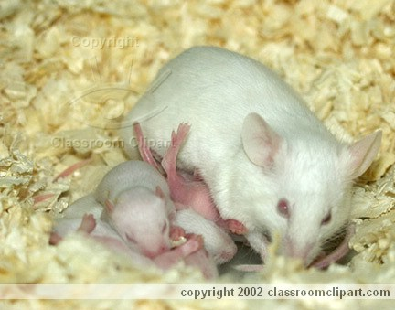

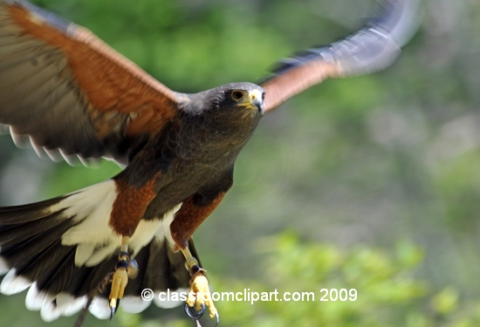
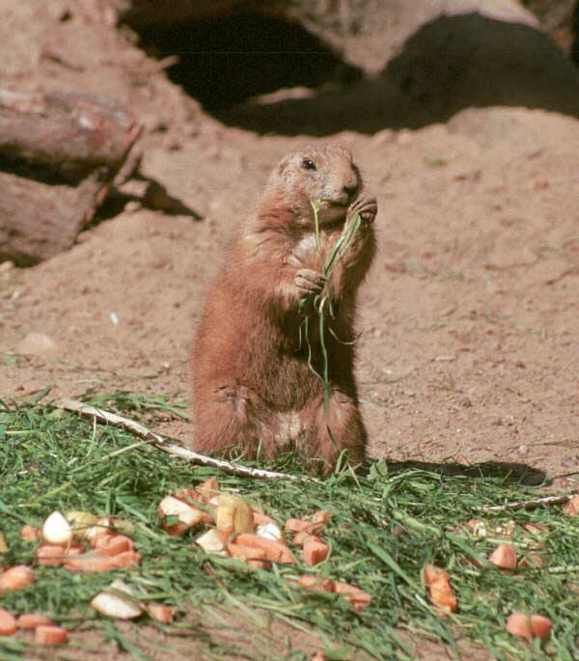
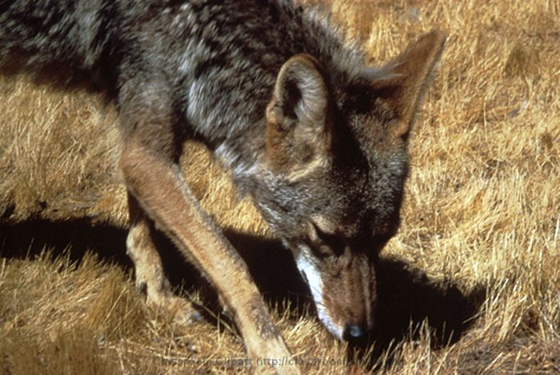
Here are some biotic factors, or living organisms, found in a grassland ecosystem.
mice
clover
hawk
prairie dog
coyote

Slide 12
Mr. Brown: There is one more thing about ecosystems you should know. Changes in the abiotic and biotic factors affect the organisms living there.
Allison: How can that happen?
Mr. Brown: Weather, natural disasters, and even humans can be responsible for these changes. Look at these examples.

Slide 13

A lightning strike can start a forest fire! A fire will destroys trees and other plants. If the animals survive, they will have lost their habitat.

Slide 14
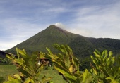
A volcanic eruption such as this one, or an earthquake are two other natural disasters that will change an ecosystem.

Slide 15
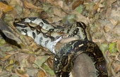
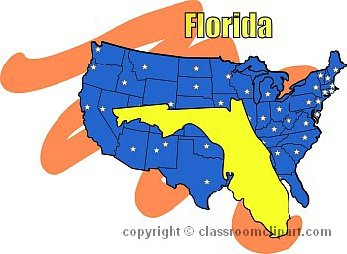
In Florida, people have released snakes, such as boa constrictors and pythons, into the wild. These snakes have no natural predators, produce large numbers of offspring, and will eat almost all of the birds and mammals that are native to this ecosystem. The native species are in danger and the natural food web has been disrupted.

Slide 16
Mr. Brown: Well, Allison, have you learned a little about ecosystems?
Allison: I have! Thanks for sharing some facts
about ecosystems with me today, Mr. Brown.

